Slide 1
Community-based Sustainable Tourism Haa Dzongkhag
Presented by:
Tshering Choki, RSPN
Akane Suga, JEEF

Slide 2
Tourism in Bhutan
Tourism – A government initiative in 1974
to generate revenue
to promote the natural and cultural heritage
A major step in opening up from isolation
Regulated policy - High value low volume
Evolved as a preferred tourist destination
Product domains:
unique culture and traditions
rich natural environment
Spirituality
Notes:
Tourism is Bhutan was initiated

Slide 3
Tourism in Bhutan
Trends
Number of tourists
State owned to private
State owned Bhutan Tourism Corporation Limited to thousands of Tour operators
Product diversification
Community based tourism
Coverage
Focus on eastern Bhutan
Low trickle down effect

Slide 4
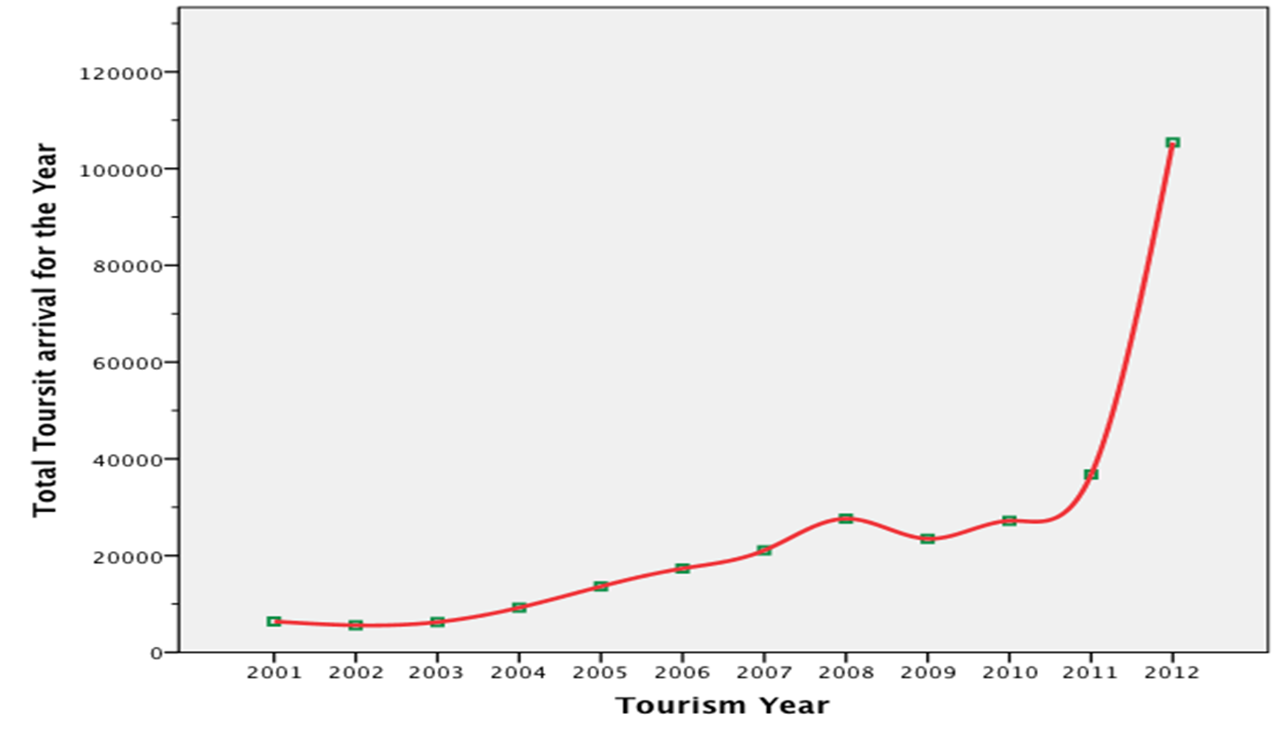
Tourism in Bhutan
Notes:
Tourism is Bhutan was initiated

Slide 5
Bhutan’s approach to modern development – GNH
High priority to preservation and protection of its fragile mountain ecosystem and natural resources
Emphasized in Article 5 of the constitution and associated Acts, rules and regulations
Environmental considerations in development
• Focus on non-exploitative renewable natural resources
RSPN efforts to supplement government initiatives
RSPN piloted projects to explore alternative income options that are based on the principles of sustained environmental conditions
Sustainable tourism – viable in terms of both environment and development

Slide 6
Why CBST in Haa
Recent to tourism access and development (opportunity for sustainable tourism development)
Least travelled tourism destination in Western Bhutan – refer graph
Diverse cultural and natural resources
Very close to Paro International Airport

Slide 7
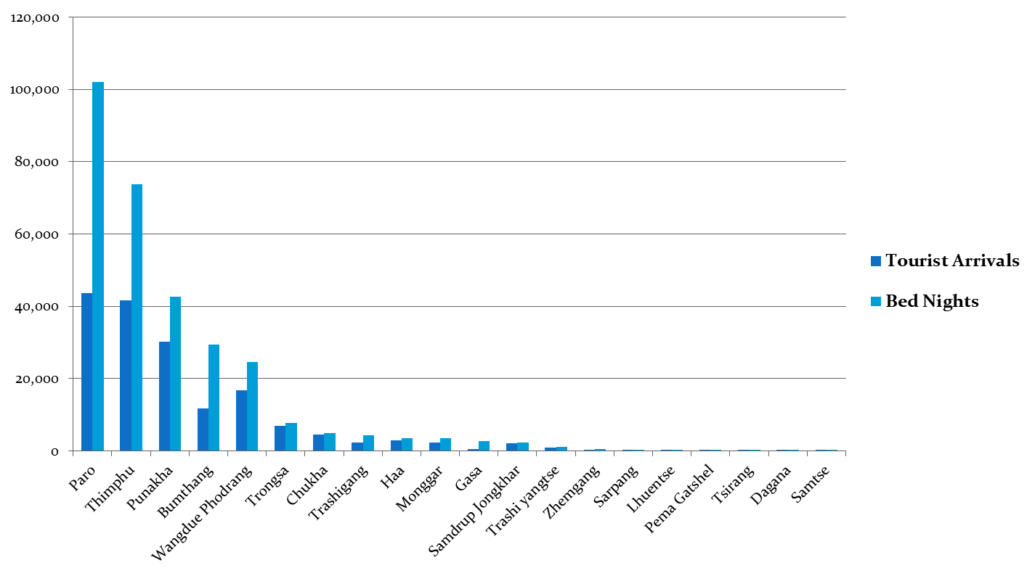
Tourist arrival & bednights in Dzongkhags
Haa
Arrival: 2811
Bednights: 3532
Notes:
Tourism is Bhutan was initiated

Slide 8
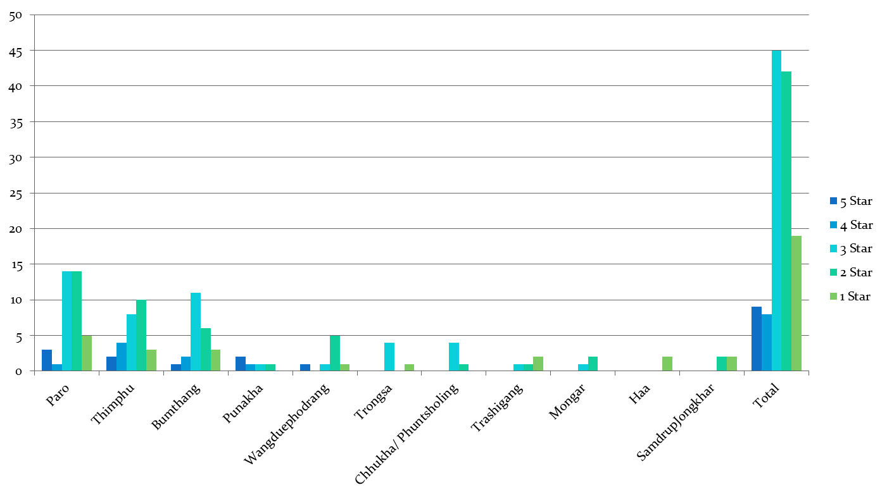
Catagories of Accomodation in Dzongkhags

Slide 9
Project Background
Duration: 3 years (26th January 2015 –31st January 2018)
Project Donor: JICA under the JICA Partnership Program
Project Counterpart (international): Japan Environmental Education Forum (JEEF)
Project Area: Bjee, Katsho & Uesu Gewogs (Zone 1)

Slide 10
Project Objective
Contribute to establishment of Haa as a community-based sustainable tourism destination that contributes to conservation of the natural environment, conservation of culture, and at the same time contributes to socio-economic benefits of the local communities.

Slide 11
Project Activities
Institutional Mechanism & Network Strengthening
Establish CBST steering committee at national level
Establish working group at local level
Conduct awareness , capacity building and meeting for steering committee members and working group
Understand clear direction of Haa as a CBST destination
Conduct baseline assessment survey (product diversification)
Develop a sustainable tourism framework for Haa

Slide 12
Project Activities
Develop CBST Products & Services
Develop and train homestays
Develop homestay guidelines
Train local guides
Explore, design and train souvenir production
Explore scopes for developing a Visitor Centre
Marketing & Promotion
Organize tour packages to be that can be promoted by
Developing website and promotional materials
Using media and magazines

Slide 13
Project Activities
Establish CBST Management Mechanism
Develop a business plan for Haa CBST
Explore options or form a CBST Group
Train the CBST Group in management skills
Replication of CBST for other Dzongkhags
Involve representatives from the three districts of Mongar, Lhuentse and Trashiyangtse during trainings and meetings.
Guide them in developing CBST proposals

Slide 14
THANK YOU

